Slide 1
Spring security – Keyclock
https://www.youtube.com/playlist?list=PLHXvj3cRjbzs8TaT-RX1qJYYK2MjRro-P

Slide 2
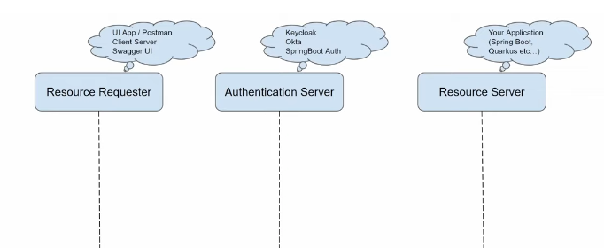
Authentication & Authorization

Slide 3
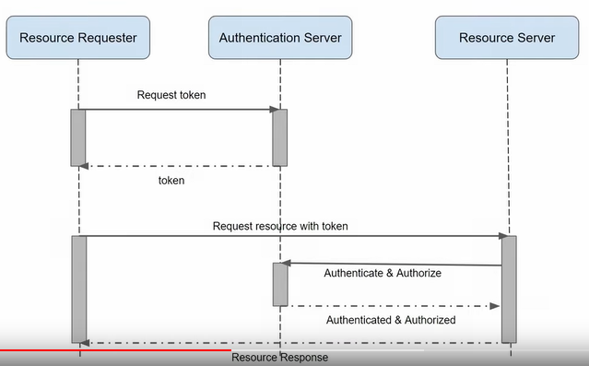
Authentication & Authorization

Slide 4
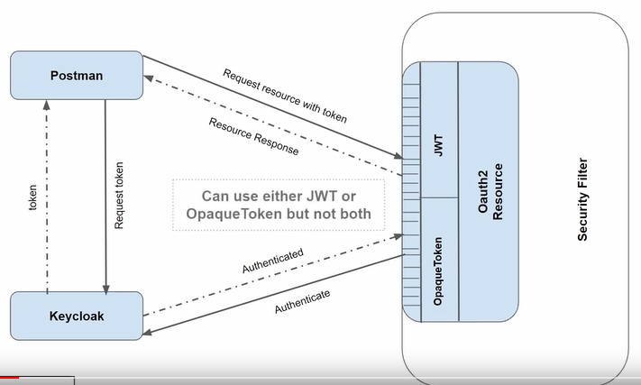
Authentication Process
Client
Resource Server
Auth
Server

Slide 5
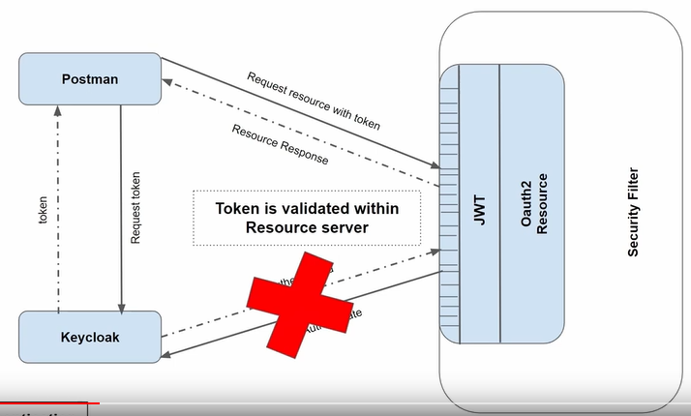
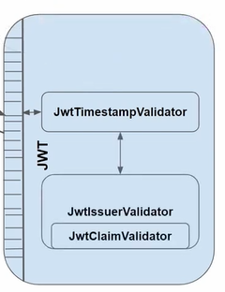
Authentication Process --- JWT (self token validation)
JWT token validation process

Slide 6
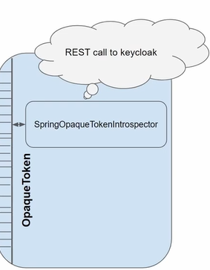
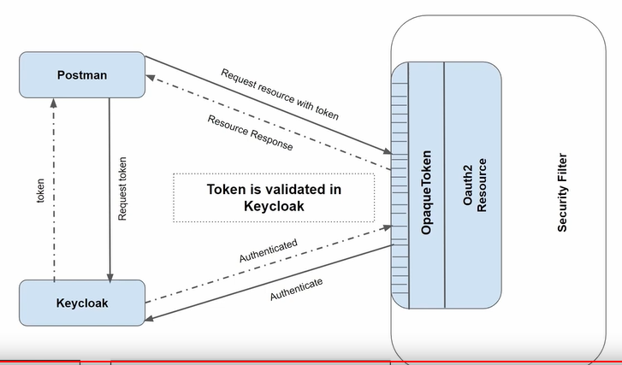
Authentication Process -- Opaque Token in keyclock side

Slide 7
Authentication Process

Slide 8
Authentication & Authorization

